Slide 1

_{Major-II} _{School of Computer Science} University of Petroleum & Energy Studies, Dehradun
Project Title
Conversion Of Hand Written Text into Text Using Computer Vision
Created by:- Mentor:-
Adesh Kumar Gupta Dr. Hitesh Kumar Sharma
Shankey Gupta Assistant Professor-SS
Tushar Singh School of Computer Science
Utkarsh Sandeep Singh

Slide 2
CONTENTS
ABSTRACT
INTRODUCTION
PROBLEM STATEMENT
OBJECTIVE
METHODOLOGY
PERT CHART
USE CASE
FLOW CHART
CNN ARCHITECTURE
ALGORITHM
PROGRESS
RESULTS
REFRENCES

Slide 3
Abstract
This tool is useful for recognizing all alphabets (English) given as in input image. Once input image of character is given to proposed system, then it will recognize input character which is given in image. Recognition and classification of characters are done by Neural Network. The main aim of this project is to effectively recognize a particular character of type format using the Artificial Neural Network approach.

Slide 4
Introduction
The system will be developed in the python language which is the go-to language when it comes to ML/DL application as it provides ample number of libraries to develop an end to end tool which takes grayscale image of a letter as input according to its pixel values and converts it into computer text.
We have also measured and compared the accuracy of different machine learning classification algorithm.

Slide 5
Problem Statement
Existing hand writing recognition systems use complex architecture which are not beginner friendly and are modified in a way such that they can be used with only their specific software therefore this project was to develop an easy to understand hand writing recognition system which is easy to use and understand and is compatible in all environment.

Slide 6
Objective
Here we are delivering an end-to-end tool which will used to identify the characters of text given by end-user and help him/her convert it into text.
To construct suitable neural network and train it properly to recognize characters.
Reduce man-power to convert text into digitized form manually.

Slide 7
Methodology
Machine Learning Techniques like Logistic Regression, SVM, Decision Tree, Random Forest and CNN are very powerful classification techniques when it comes to finding a trend between the variables and classify them under a category. Generally, all Machine Learning techniques follow a similar procedure-
• Get Data for different Sources etc.
• Extract Important Features to work on.
• Choose a Machine Learning Model.
• Train the model, improve it and test it.
• Lastly, Deploy and Service the end user.

Slide 8
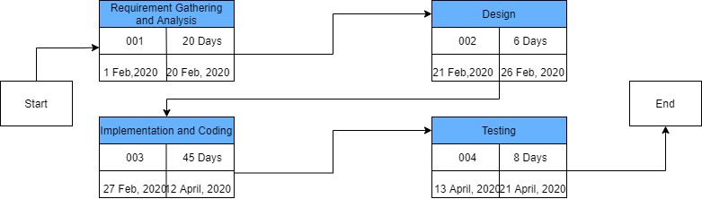
Pert Chart

Slide 9
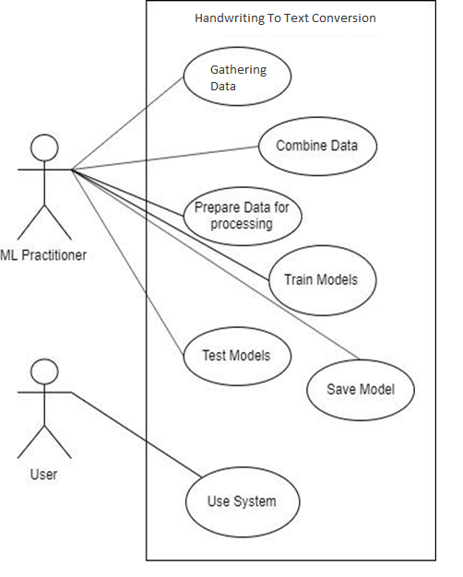
Use Case

Slide 10
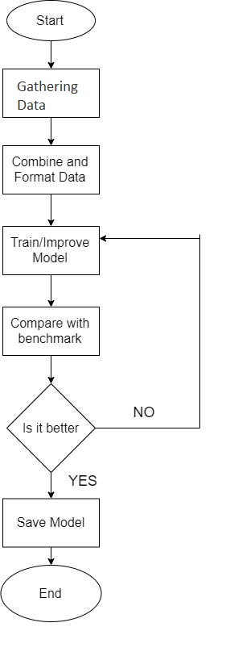
Flow Chart

Slide 11
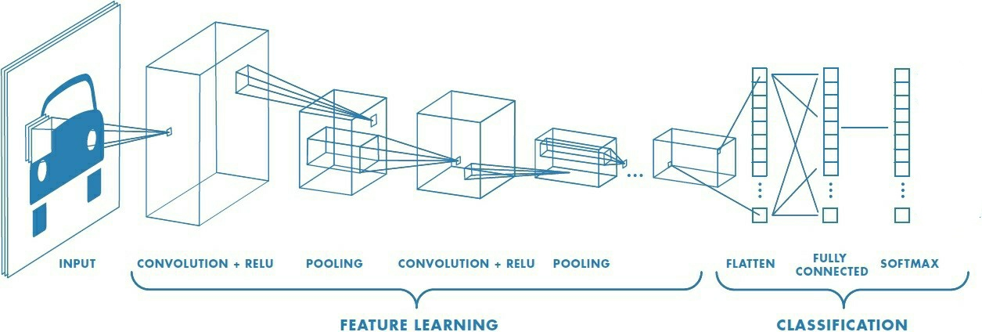
CNN - Architecture

Slide 12
Algorithm
CNN
define get_image_define size() to get the image shape and size
define get_num_of_classes() to store the number of classes
define cnn_model()
get the number of classes
model.add(conv2d(notes, filters, kernel size, activation function))
model.add (maxpooling2D(poolsize ,strides))
model.add (conv2d( filters, kernel size, activation function))
model.add (maxpooling2D(poolsize ,strides))
model.add (flatten())
model.add(Dense(num_of_classes, activation='softmax'))
model.compile(loss='categorical_crossentropy', optimizer, metrics=accuracy)
plot model
return model

Slide 13
Model Fitting
model.fit(train_images, train_labels, validation_data=(val_images, val_labels), epochs=10, batch_size=500, callbacks=callbacks_list)
scores = model.evaluate(val_images, val_labels, verbose=0)
print(CNN Error)
call train()

Slide 14


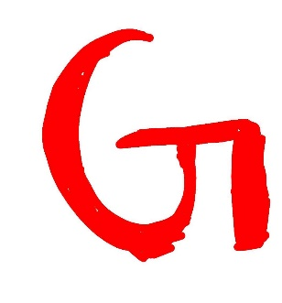





Progress
Data Image

Slide 15
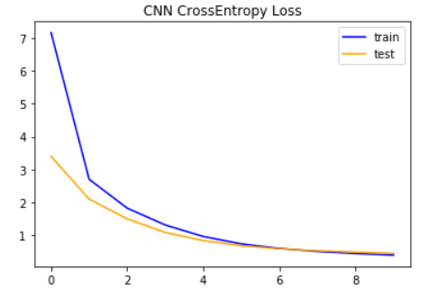
Model Loss
Loss
Epochs

Slide 16
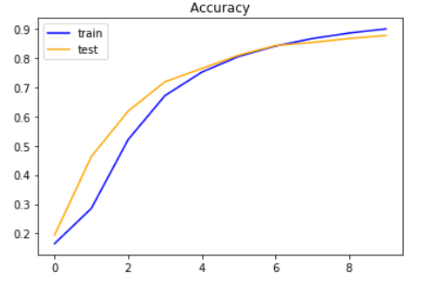
Model Accuracy
Accuracy
Epochs

Slide 17
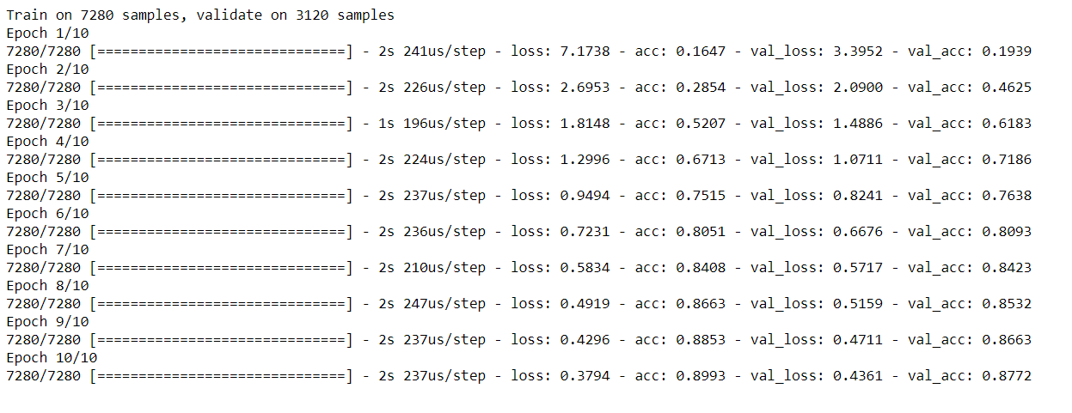
Results
CNN Score: 89% (after 10 epochs)

Slide 18
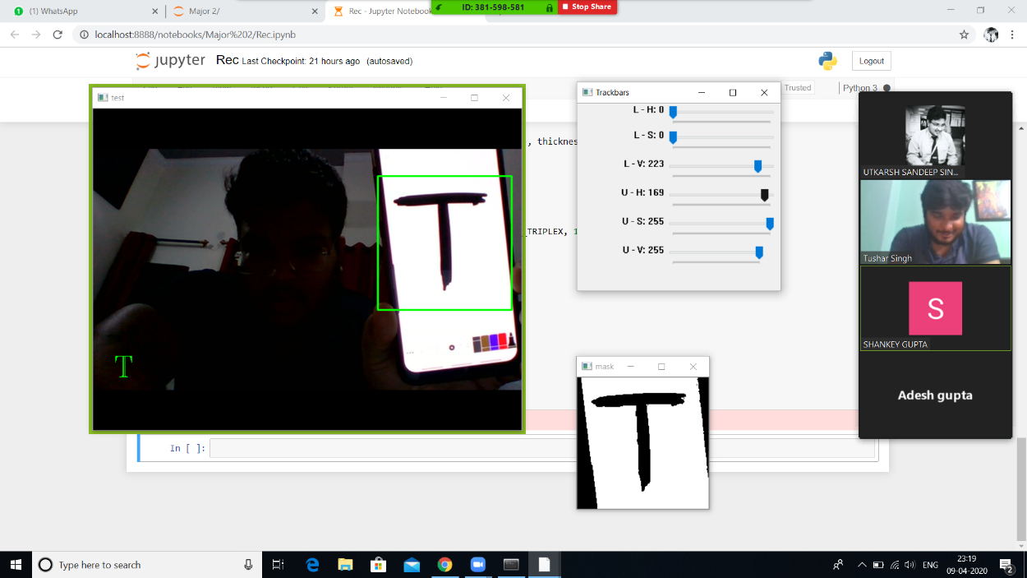
Character Recognization

Slide 19
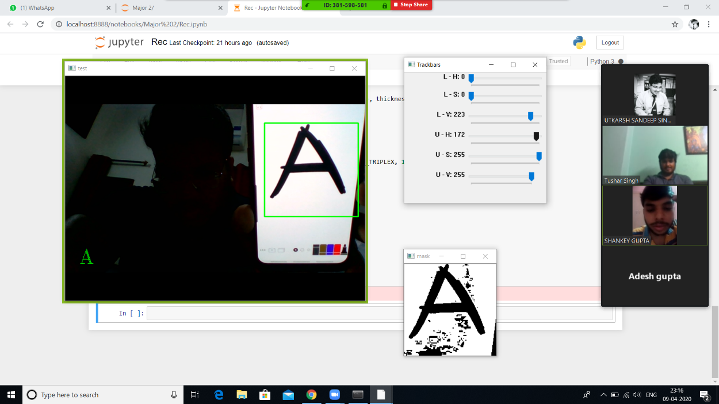
Character Recognization

Slide 20
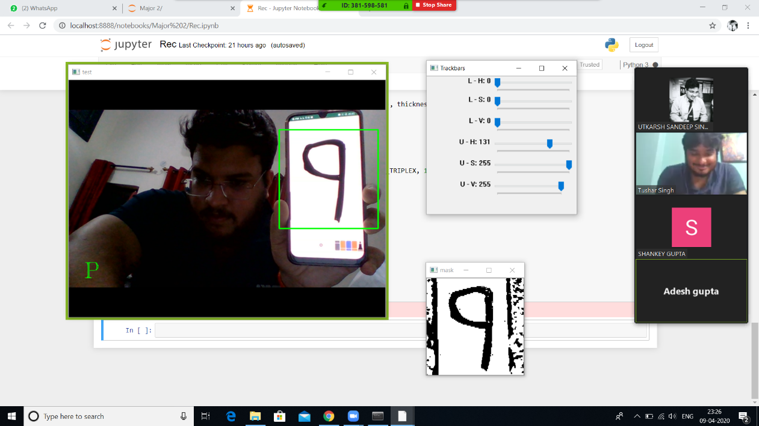
Character Recognization

Slide 21
References
Isha Vats, Shamandeep Singh, “Offline Handwritten English Numerals Recognition using Correlation Method”, International Journal of Engineering Research and Technology (IJERT): ISSN: 2278-0181 Vol. 3 Issue 6, June 2014. Access Date: 09/07/2015.
Gunjan Singh,Sushma Lehri, “ Recognition of Handwritten Hindi Characters using Back propagation Neural Network”, International Journal of Computer Science and Information Technologies ISSN 0975-9646, Vol. 3 (4) , 2012,4892-4895. Access Date:09/07/2015.
S S Sayyad, Abhay Jadhav, Manoj Jadhav, Smita Miraje, Pradip Bele, Avinash Pandhare, ‘Devnagiri Character Recognition Using Neural Networks” ,International Journal of Engineering and Innovative Technology (IJEIT)Volume 3, Issue 1, July 2013. Access Date: 09/07/2015.
Shabana Mehfuz,Gauri katiyar, ‘Intelligent Systems for Off-Line Handwritten Character Recognition: A Review” ,International Journal of Emerging Technology and Advanced Engineering Volume 2, Issue 4, April 2012. Access Date: 09/07/2015.
Prof. Swapna Borde, Ms. Ekta Shah, Ms. Priti Rawat, Ms. Vinaya Patil, “Fuzzy Based Handwritten Character Recognition System” ,International Journal of Engineering Research and Applications (IJERA) ISSN: 2248-9622,VNCET 30 Mar’12. Access Date: 09/07/2015.

Slide 22
THANKYOU

